Slide 1
Heterogeneous Treatment Effect Models and Inference
Julian Hsu

Slide 2
Overview
This presentation covers the general problem of estimating heterogeneous treatment effects (HTE) and how it differs from ATE/ATET estimation.
We will briefly cover a few models:
Double Machine Learning following Semenova et al. (2021)
Heterogeneous Residuals
Generalized Random Forests - Causal Forests
“Proxy” models
Wrap up with a simulation demonstration

Slide 3
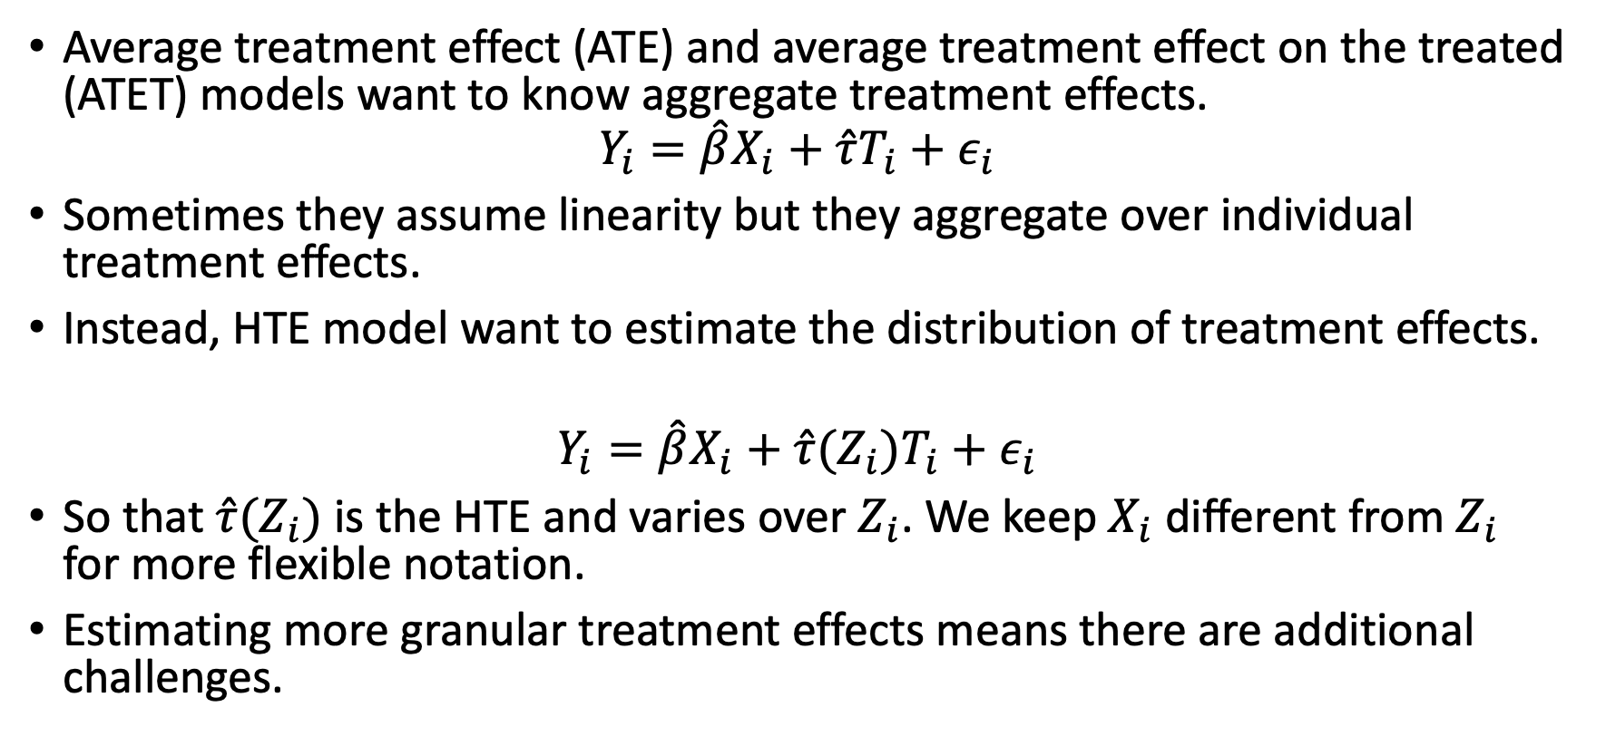
HTE Overview
Average treatment effect (ATE) and average treatment effect on the treated (ATET) models want to know aggregate treatment effects.
$$Y_{i}=\hat{β}X_{i}+\hat{τ}T_{i}+ε_{i}$$
Sometimes they assume linearity but they aggregate over individual treatment effects.
Instead, HTE model want to estimate the distribution of treatment effects.
$$Y_{i}=\hat{β}X_{i}+\hat{τ}(Z_{i})T_{i}+ε_{i}$$
So that $\hat{τ}(Z_{i})$is the HTE and varies over $Z_{i}$. We keep $X_{i}$ different from $Z_{i}$ for more flexible notation.
Estimating more granular treatment effects means there are additional challenges.
Notes:
Note that inference and standard errors is *required* for HTE models, just like for ATE/ATET models.

Slide 4
HTE ideal experiment
We can understand two extremes by considering what the ideal experiment is to estimate unbiased HTE.
For individualized HTE, the ideal is to randomize treatment for each individual. (impossible)
For segmented HTE, the ideal is to randomize treatment for each segment. (stratified randomization)
The more individualized HTE is, the more data and assumptions are needed to distinguish between real patterns and statistical noise in the data.
Notes:
Statistical inference for ATE/ATET estimates is based on the distribution of error around the average estimate.
The challenge is getting a distribution around an individual estimate.
The solution is to rely on either model specifications or bootstrapping-esque methods.

Slide 5
Some HTE Models

Slide 6
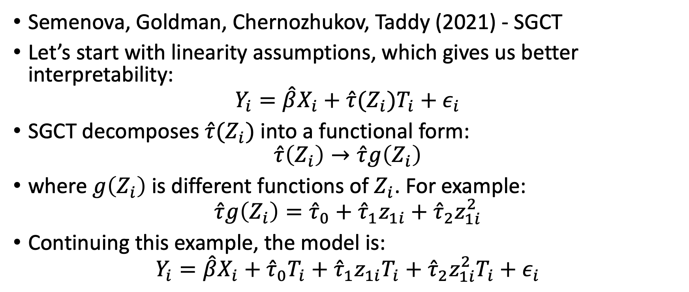
DML-Style Models
Semenova, Goldman, Chernozhukov, Taddy (2021) - SGCT
Let’s start with linearity assumptions, which gives us better interpretability:
$$Y_{i}=\hat{β}X_{i}+\hat{τ}(Z_{i})T_{i}+ε_{i}$$
SGCT decomposes $\hat{τ}(Z_{i})$ into a functional form:
$$\hat{τ}\left(Z_{i}\right)→\hat{τ}g\left(Z_{i}\right)$$
where $g\left(Z_{i}\right)$ is different functions of $Z_{i}$. For example:
$$\hat{τ}g\left(Z_{i}\right)={\hat{τ}}_{0}+{\hat{τ}}_{1}z_{1i}+{\hat{τ}}_{2}z_{1i}^{2}$$
Continuing this example, the model is:
$$Y_{i}=\hat{β}X_{i}+{\hat{τ}}_{0}T_{i}+{\hat{τ}}_{1}z_{1i}T_{i}+{\hat{τ}}_{2}z_{1i}^{2}T_{i}+ε_{i}$$

Slide 7
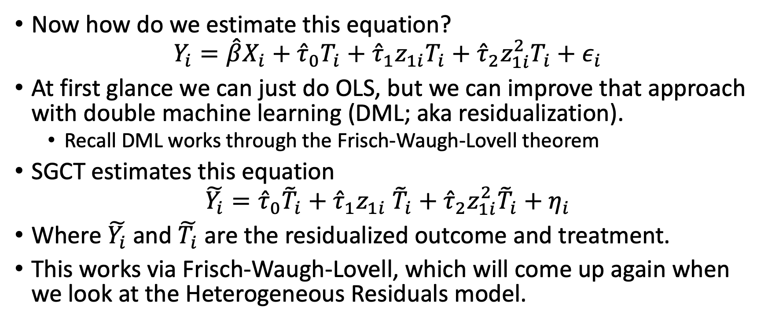
SGCT uses residualization
Now how do we estimate this equation?
$$Y_{i}=\hat{β}X_{i}+{\hat{τ}}_{0}T_{i}+{\hat{τ}}_{1}z_{1i}T_{i}+{\hat{τ}}_{2}z_{1i}^{2}T_{i}+ε_{i}$$
At first glance we can just do OLS, but we can improve that approach with double machine learning (DML; aka residualization).
Recall DML works through the Frisch-Waugh-Lovell theorem
SGCT estimates this equation
$$\tilde{Y_{i}}={\hat{τ}}_{0}{\tilde{T}}_{i}+{\hat{τ}}_{1}z_{1i} {\tilde{T}}_{i}+{\hat{τ}}_{2}z_{1i}^{2}{\tilde{T}}_{i}+η_{i}$$
Where $\tilde{Y_{i}}$ and $\tilde{T_{i}}$ are the residualized outcome and treatment.
This works via Frisch-Waugh-Lovell, which will come up again when we look at the Heterogeneous Residuals model.

Slide 8
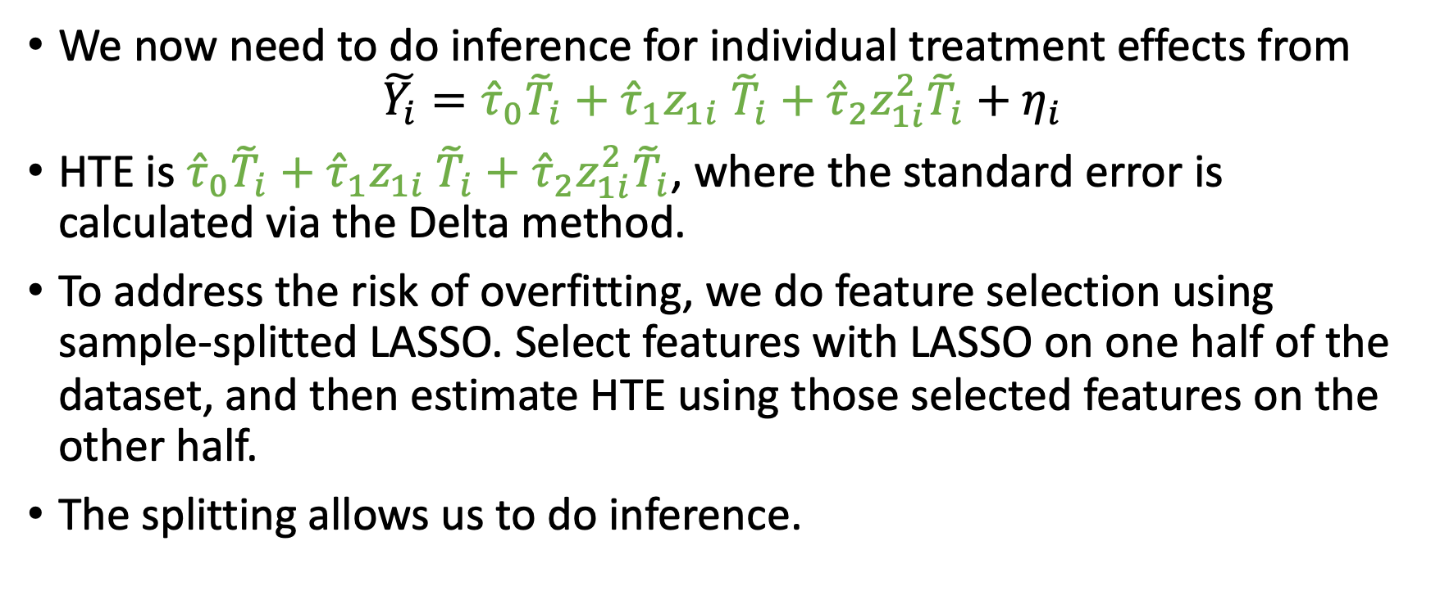
SGCT – HTE and inference
We now need to do inference for individual treatment effects from
$$\tilde{Y_{i}}={\hat{τ}}_{0}{\tilde{T}}_{i}+{\hat{τ}}_{1}z_{1i} {\tilde{T}}_{i}+{\hat{τ}}_{2}z_{1i}^{2}{\tilde{T}}_{i}+η_{i}$$
HTE is ${\hat{τ}}_{0}{\tilde{T}}_{i}+{\hat{τ}}_{1}z_{1i} {\tilde{T}}_{i}+{\hat{τ}}_{2}z_{1i}^{2}{\tilde{T}}_{i}$, where the standard error is calculated via the Delta method.
To address the risk of overfitting, we do feature selection using sample-splitted LASSO. Select features with LASSO on one half of the dataset, and then estimate HTE using those selected features on the other half.
The splitting allows us to do inference.
Notes:
We can use OLS to estimate the above equation if:
There are few dimensions of heterogeneity (ie $g\left(Z_{i}\right)$is low dimensional); or
We are interested in specific dimensions of heterogeneity (ie we only want to know HTE across account tenure)

Slide 9
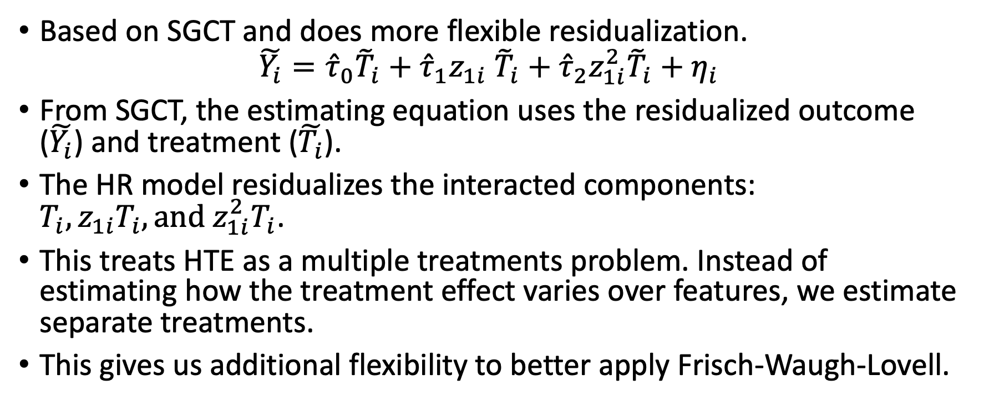
Heterogeneous residuals (HR)
Based on SGCT and does more flexible residualization.
$$\tilde{Y_{i}}={{\hat{τ}}_{0}{\tilde{T}}_{i}+\hat{τ}}_{1}z_{1i} {\tilde{T}}_{i}+{\hat{τ}}_{2}z_{1i}^{2}{\tilde{T}}_{i}+η_{i}$$
From SGCT, the estimating equation uses the residualized outcome ($\tilde{Y_{i}}$) and treatment ($\tilde{T_{i}}$).
The HR model residualizes the interacted components: $T_{i}, z_{1i}T_{i},{\text{and} z_{1i}^{2}T}_{i}$.
This treats HTE as a multiple treatments problem. Instead of estimating how the treatment effect varies over features, we estimate separate treatments.
This gives us additional flexibility to better apply Frisch-Waugh-Lovell.
Notes:
There is a minor point here about how reasonable it is to condition on the squared version of a variable. However, we can make the same argument if instead of $z_{1i}$, we had $z_{2i}$. Note the argument ${\tilde{T}}_{i}$ contains information about the other covariates does not hold because by construction it has to be uncorrelated with other features.
The linear expectation is done because OLS implicitly does a linear expectation for residualization. You can see this yourself if you were to use OLS (without any cross-fitting) in a simple DML model.

Slide 10
Generalized Random Forests
Causal forests are a special class of generalized random forests, which we will discuss here.
It differs in that it uses a non-parametric approach to estimating HTE.

Slide 11
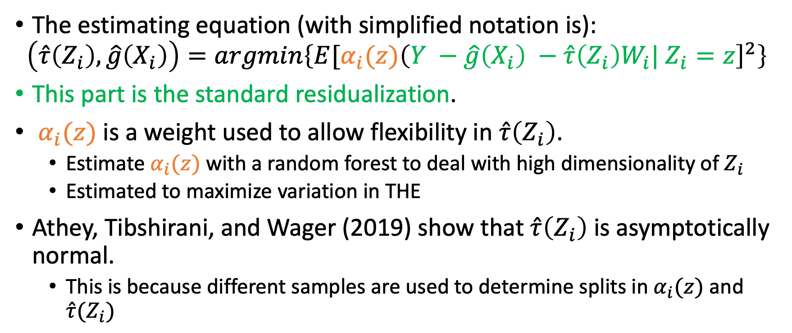
GRF – Causal Forest Objective Function
The estimating equation (with simplified notation is):
$$\left(\hat{τ}\left(Z_{i}\right), \hat{g}\left(X_{i}\right)\right)=argmin\left\{E[α_{i}(z){\left(Y −\hat{g}\left(X_{i}\right) −\hat{τ}{\left(Z_{i}\right)W}_{i}| Z_{i}=z\right]}^{2}\right\}$$
This part is the standard residualization.
$α_{i}(z)$ is a weight used to allow flexibility in $\hat{τ}\left(Z_{i}\right)$.
Estimate $α_{i}(z)$ with a random forest to deal with high dimensionality of $Z_{i}$
Estimated to maximize variation in THE
Athey, Tibshirani, and Wager (2019) show that $\hat{τ}\left(Z_{i}\right)$ is asymptotically normal.
This is because different samples are used to determine splits in $α_{i}(z)$ and $\hat{τ}(Z_{i})$
Notes:
Standard errors and confidence intervals are available based on a bootstrap/jackknife approach.
Bootstrap/Jackknife approach: Intuitively, estimate the distribution in $\hat{τ}(z)$ when $z$ is removed from the sample

Slide 12
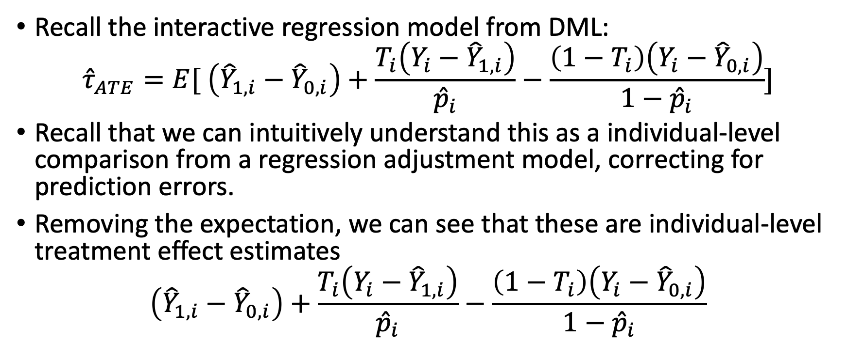
“Proxy” methods
Recall the interactive regression model from DML:
$${\hat{τ}}_{ATE}=E[ \left({\hat{Y}}_{1,i}−{\hat{Y}}_{0,i}\right)+\frac{T_{i}\left(Y_{i}−{\hat{Y}}_{1,i}\right)}{{\hat{p}}_{i}}−\frac{\left(1−T_{i}\right)\left(Y_{i}−{\hat{Y}}_{0,i}\right)}{1−{\hat{p}}_{i}}]$$
Recall that we can intuitively understand this as a individual-level comparison from a regression adjustment model, correcting for prediction errors.
Removing the expectation, we can see that these are individual-level treatment effect estimates
$$\left({\hat{Y}}_{1,i}−{\hat{Y}}_{0,i}\right)+\frac{T_{i}\left(Y_{i}−{\hat{Y}}_{1,i}\right)}{{\hat{p}}_{i}}−\frac{\left(1−T_{i}\right)\left(Y_{i}−{\hat{Y}}_{0,i}\right)}{1−{\hat{p}}_{i}}$$

Slide 13
Applying inference to the individual estimates
The problems are that these estimates:
1. Are meant to be averaged to get the ATE/ATET; and
2. Do not have inference properties.
We can reframe these as “proxy” estimates of the true HTE, and refine them with a second stage.
OLS, Kernel regression, sample-splitted LASSOs, etc.
Several papers follow this procedure: Kennedy (2020), Semenova and Chernozhukov (2020), Chernozhukov et al. (2017)
Notes:
You *could* do bootstrapping of the individual-level estimates, but that would be very computationally intensive procedure.

Slide 14
Simulation Study

Slide 15
Context
We compare performance using simulation evidence, where we can change the true HTE function
For simplicity, there is only one feature in these simulations.
We will find that the functional form assumption has a material impact on performance

Slide 16
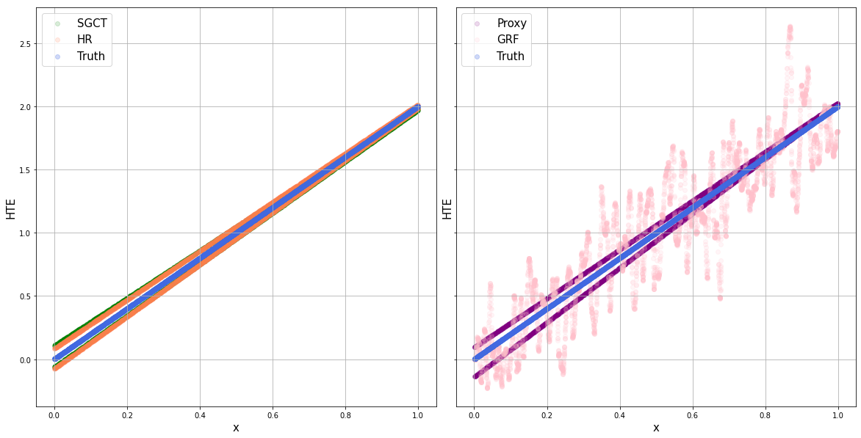
First Example – Linearity
$HTE\left(x\right)=2x$
Model controls: $x$

Slide 17
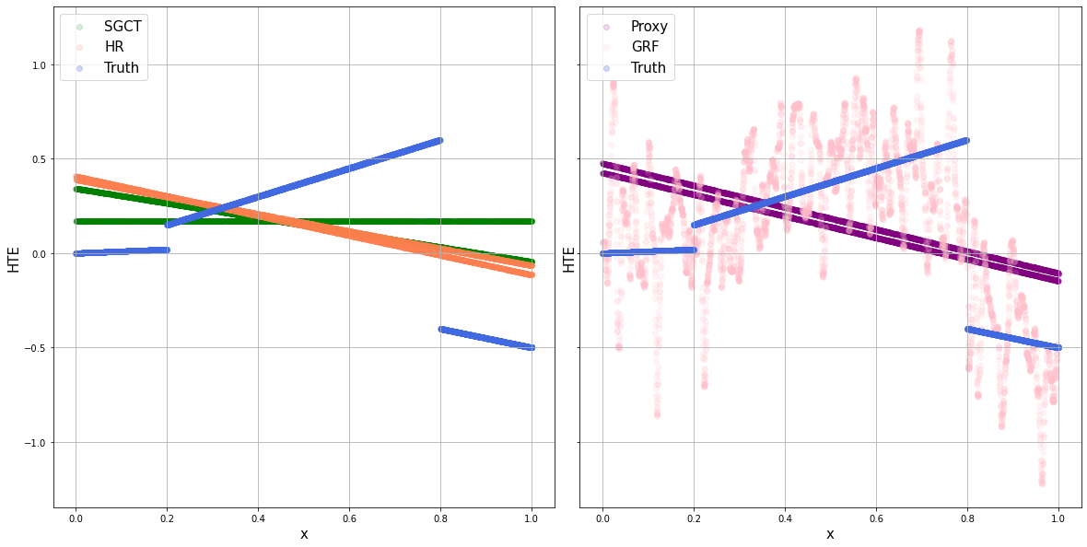
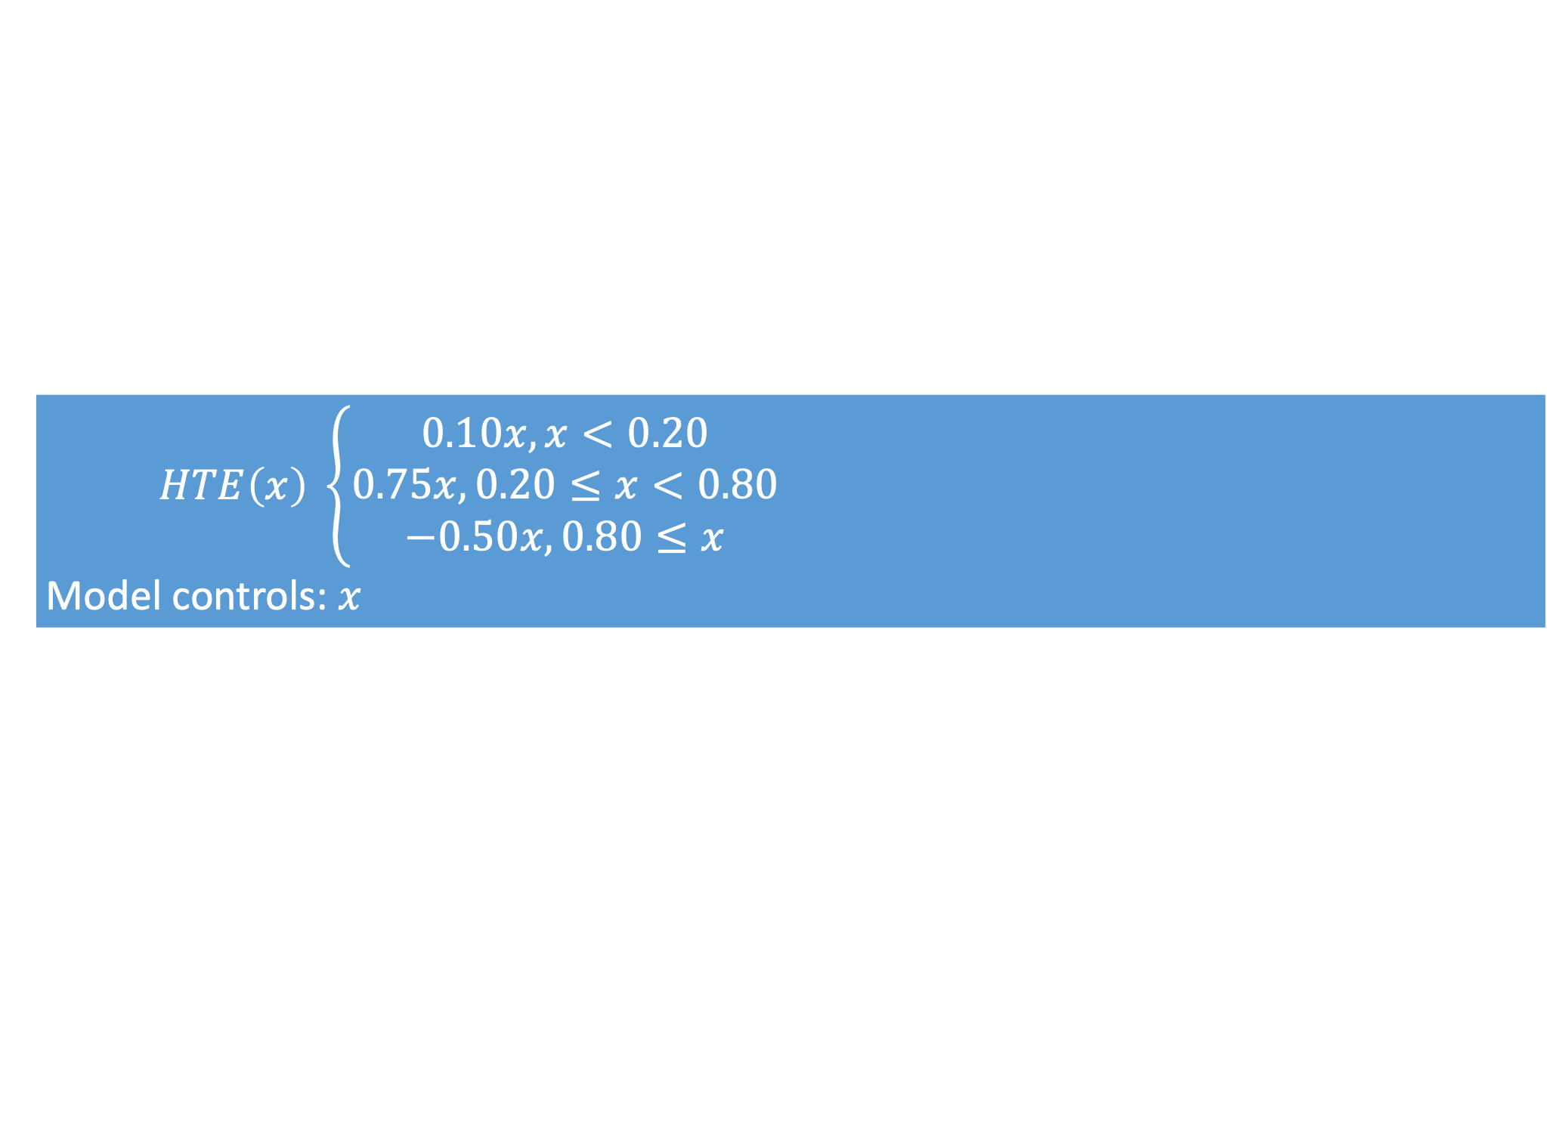
Second Example – Piece-wise
$HTE\left(x\right) \left\{\begin{aligned}0.10x, x<0.20 \\ 0.75x, 0.20≤x<0.80 \\ −0.50x, 0.80≤x\end{aligned}\right.$
Model controls: $x$

Slide 18
Takeaways and Conclusion
The functional form assumption (linear, non-parametric) has a material impact on whether you correctly estimate the HTE functions.
Including more features to estimate a more flexible HTE may not necessarily increase performance.
At a high-level, the more complicated, or more fine-grained, you want HTE estimates to be, the more data you need.
Today, we covered the additional complexities and challenges of estimating HTE and did a demonstration with simulated data

Slide 19
Appendix Slides

